Slide 1



Building RAG Q&A Bots for I/O Psychologists
A step-by-step tutorial
Notes:
Karim

Slide 2



Introductions
Yuyun Huang
Karim Badr
Paul Agnello
ML / NLP Expert
Senior Research Scientist
Senior Associate Consultant
Notes:
Karim

Slide 3
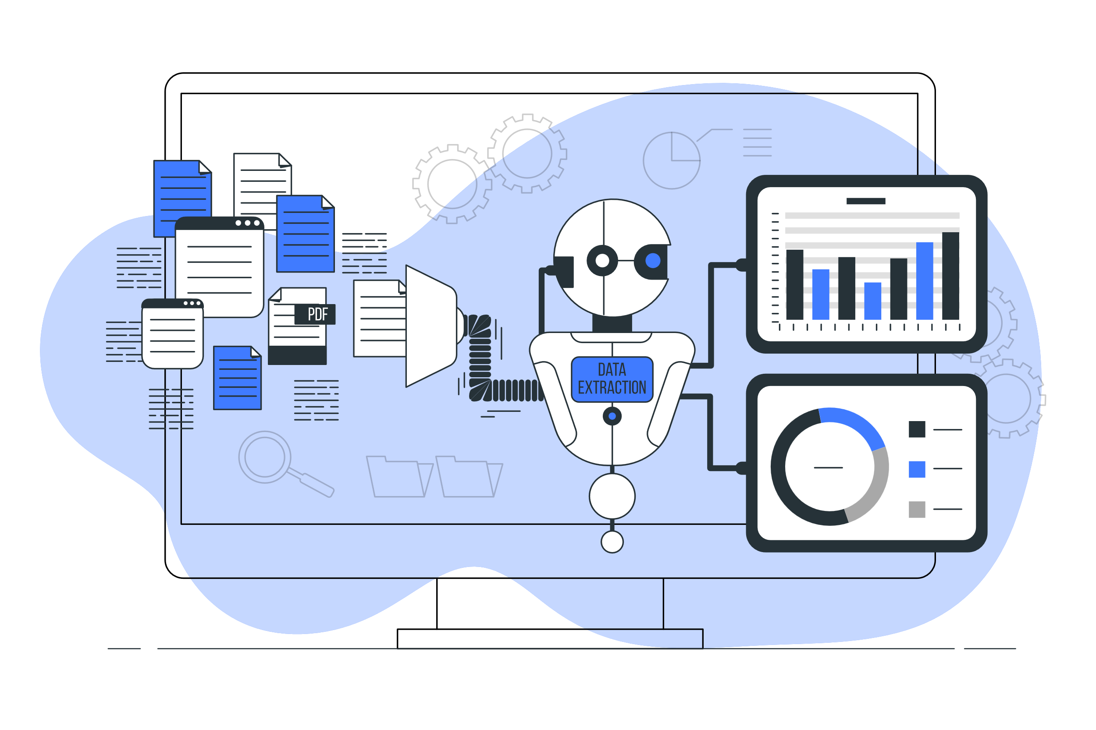




Agenda
The Basics – What is a RAG Chatbot?
The Technicals – How to Build your own Chatbot?
The Practicals – Hands-On Demos
Notes:
Karim

Slide 4
Chatbots for I/O Psychology
Industry/Practitioner:
Employee support and HR assistance
Policy and compliance queries
You can upload documents (e.g., policies or employee manuals) and ask questions about them.
Academia/Student/Researcher:
Asking questions about research articles
Industry/Practitioner:
Analyze employee surveys
Extract sentiments from comments
Analyze data
Other:
Real-time Coaching
Simulations of interactions with clients/employees/etc.
Notes:
Karim

Slide 5
RAG: An Overview
RAG:
Retrieval-Augmented Generation
It’s a way for AI to give better answers by first searching for useful info in a database (e.g., books, websites) and then using that info to make a clear and smart response.
It’s like an assistant who checks the facts before talking!
Notes:
Yuyun

Slide 6
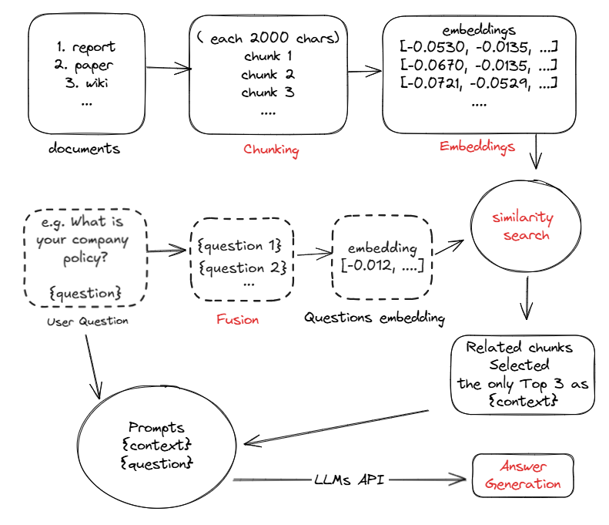
RAG: The Process

Slide 7
RAG: The Process
Chunking

Slide 8
Chunking
Definition
The process of breaking down large documents or datasets into smaller, manageable pieces (chunks) for the retriever to process.
Types
Simple Chunk (Character / Token cut, Sentence Cut)
Overlap Chunking: Add overlapping text between chunks to preserve context (e.g., 20% overlap).
Chunk with Summary: Creates chunks and generates a summary for each chunk to preserve context and aid retrieval.
Semantic Chunking: Use NLP to split based on meaning (e.g., topic shifts).
Tip: Experiment with chunking strategies based on your data and use case!

Slide 9
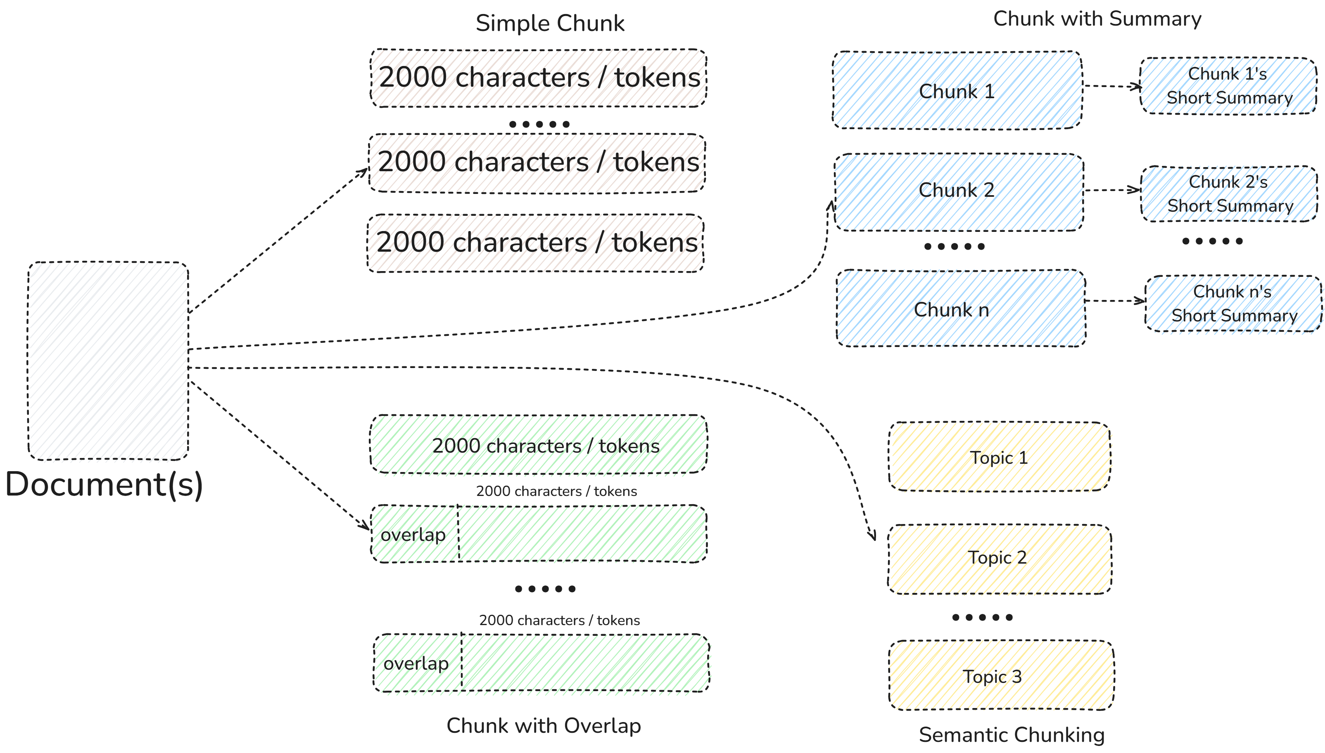
Chunking

Slide 10
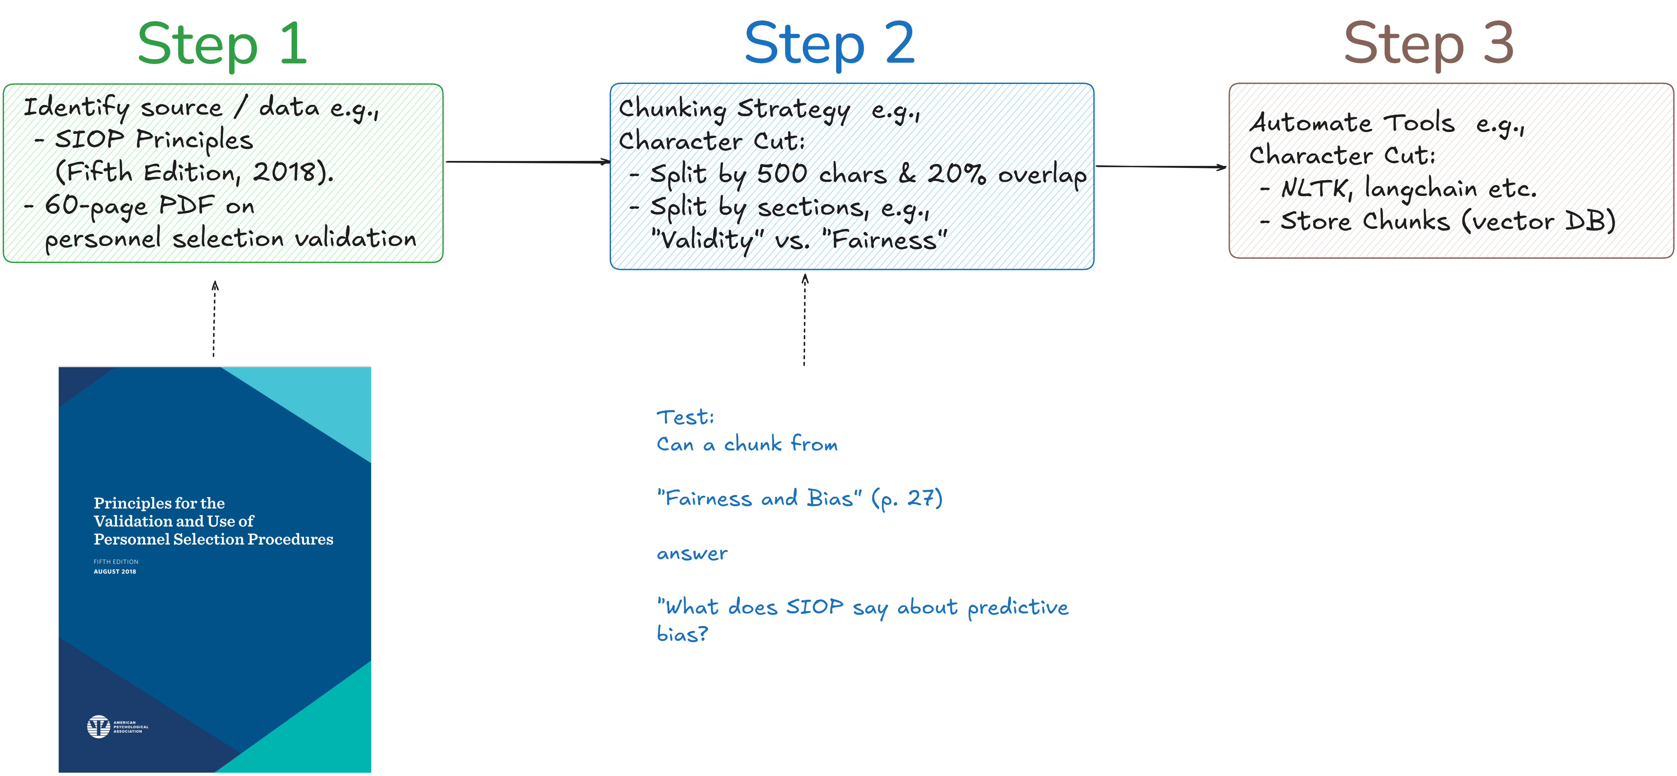
Creating Chunks

Slide 11
RAG: The Process
Embeddings

Slide 12
Embeddings
Definition
Embeddings are numerical representations (vectors) of text, images, or other data in a high-dimensional space, capturing their meaning or context.
Usage in RAG Chatbots
Enables the retriever to understand and compare the similarity between a user’s query and stored chunks.
Enables semantic search: e.g., find SIOP sections on “predictive bias” without exact keywords).

Slide 13
Embeddings

Slide 14
Creating Embeddings
Pre-trained models (e.g., all-MiniLM-L6-v2)
APIs (OpenAI's Text-embedding models)
Step 1: Pick a Model
Step 2: Process Chunks
Step 3: Generate Vectors

Slide 15
RAG: The Process
Searching

Slide 16
Searching: Topic Fusion
Fuse Topics: Split query into two richer sub-queries:
“What’s criterion validity?” →
“How is criterion validity defined?” (targets definitions).
“What evidence supports criterion validity?” (targets examples).
Embed Queries: Convert both to vectors
Compare Vectors: Match each to SIOP chunks (e.g., p. 18’s “Evidence for criterion-related validity…”).
Rank Results: Pick top 2 chunks per sub-query (4 total) using cosine similarity.
Retrieve: Return chunks with metadata (e.g., “SIOP Principles,” “p. 18”).

Slide 17
Searching: Topic Fusion

Slide 18
Searching: Cosine Similarity & Vector Search
Cosine Similarity: a measure of how close 2 vectors are
1 = identical
0 = unrelated
Example: Query “What’s criterion validity?” vs. p. 18 chunk “Evidence for criterion-related validity…” → high score (~0.9).
Tools:
FAISS (Local) : Fast vector search library
Pinecone (Cloud): Scalable vector DB

Slide 19
RAG: The Process
Prompt Forming

Slide 20
Prompt Forming
Goal: Combine query + retrieved chunk → generate coherent answer
Example:
Query: {user_query}
Context:
{retrieved_chunk1}
{retrieved_chunk2}
{retrieved_chunk3}
{retrieved_chunk4}
Answer:"

Slide 21


Build your own Chatbot – Code
Code demo in Jupyter Notebooks
Notes:
Karim

Slide 22
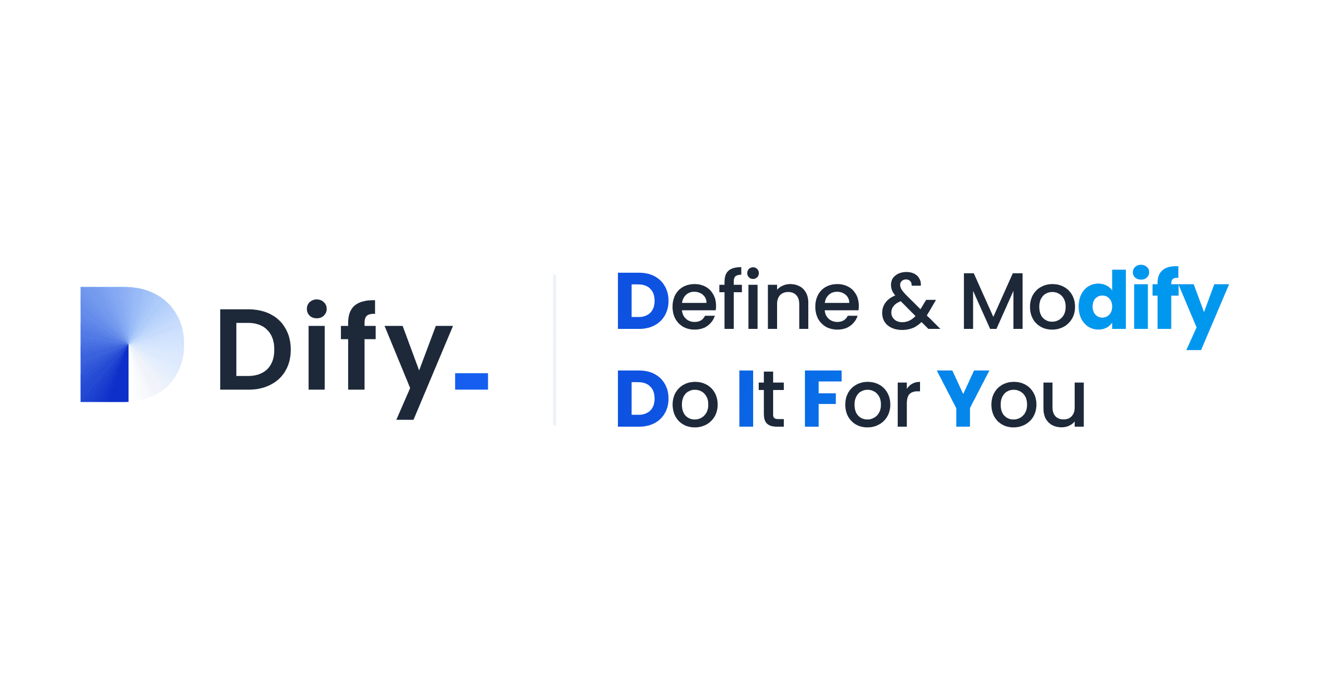
Build your own Chatbot: No Code via DIFY
Many no code tools available
Example: DIFY
Online cloud version (free & paid)
On-premises (Open-source, install on your server)
DIFY Demo
https://dify.ai/
Notes:
Paul

Slide 23
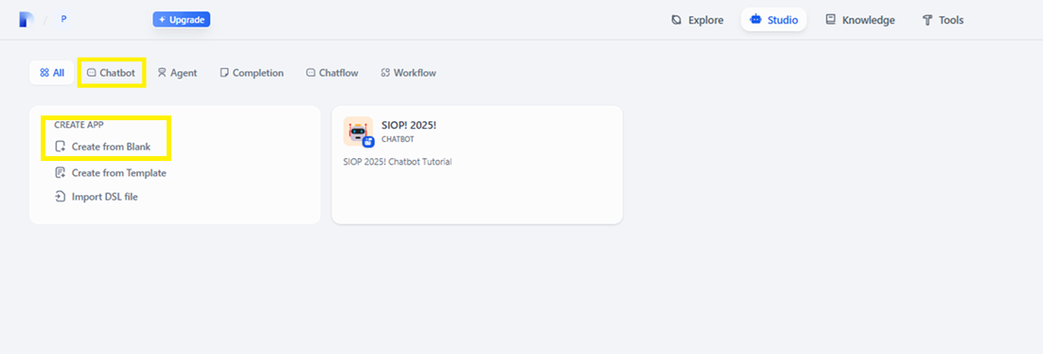
DIFY: Landing Page

Slide 24
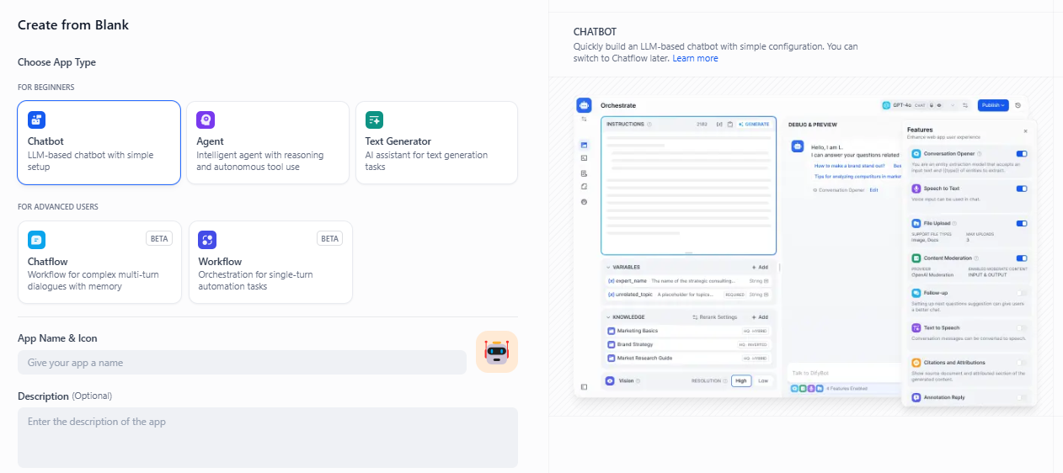
DIFY: Chatbot

Slide 25
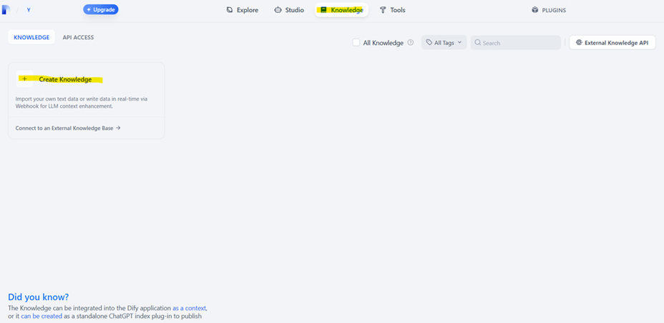
DIFY: Create Knowledge

Slide 26
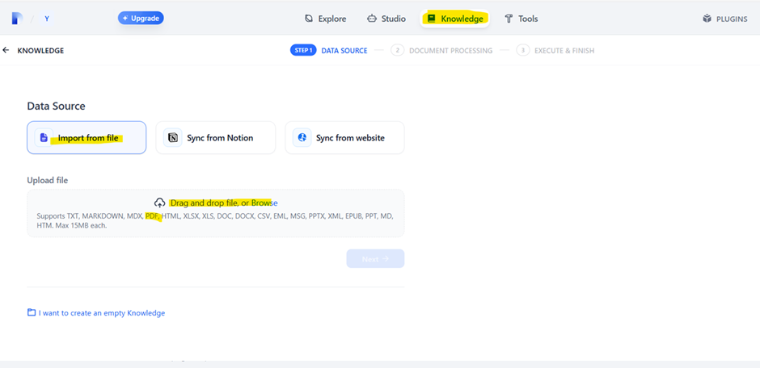
DIFY: Upload Files

Slide 27
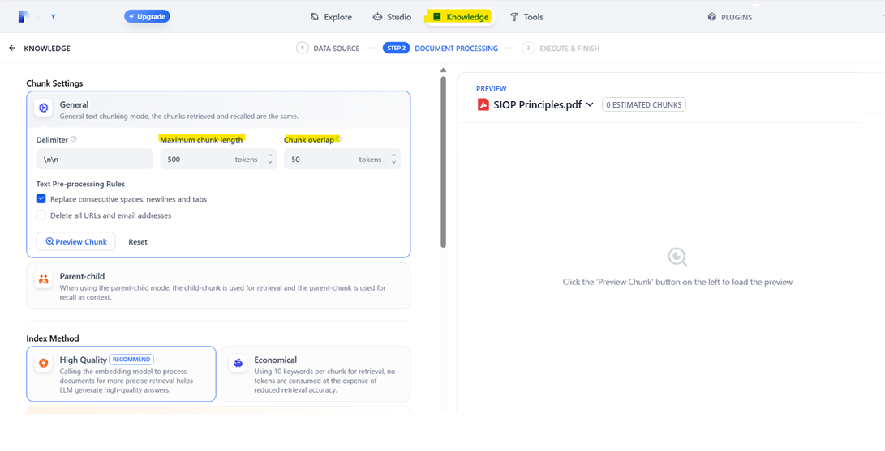
DIFY: Text Chunking

Slide 28
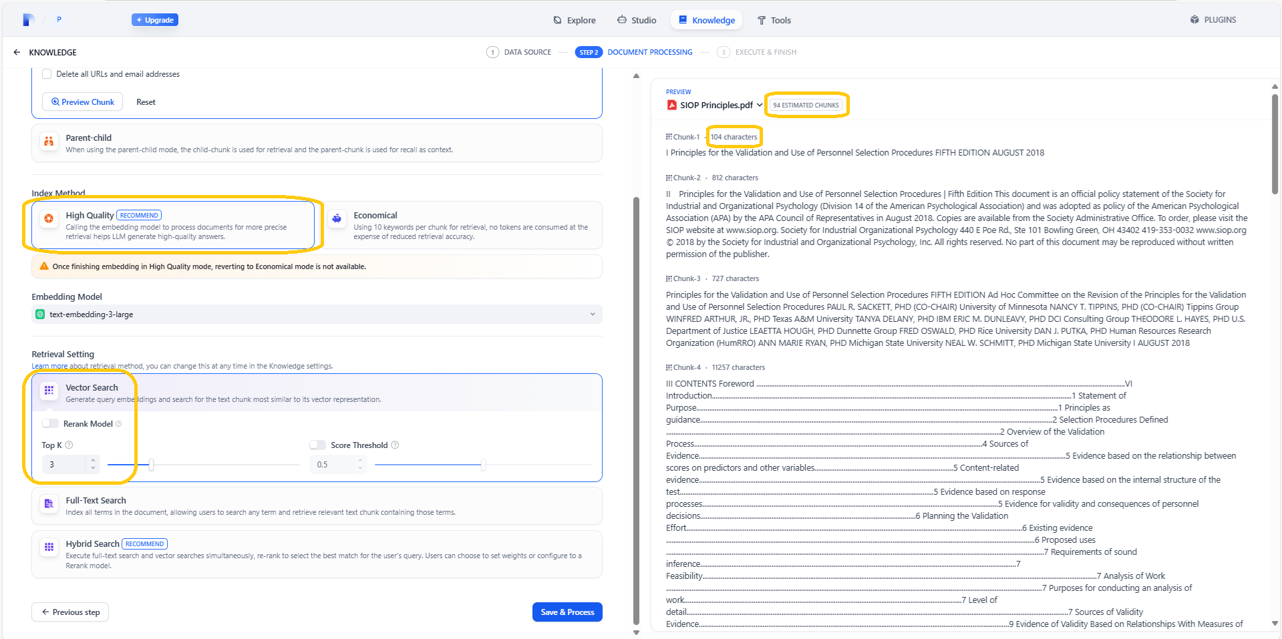
DIFY: Embedding

Slide 29
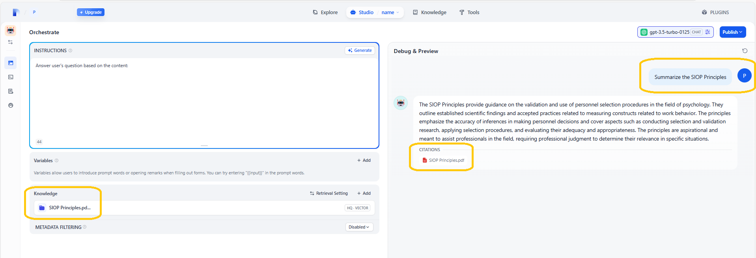
DIFY: Debugging & Trialing the Chatbot

Slide 30
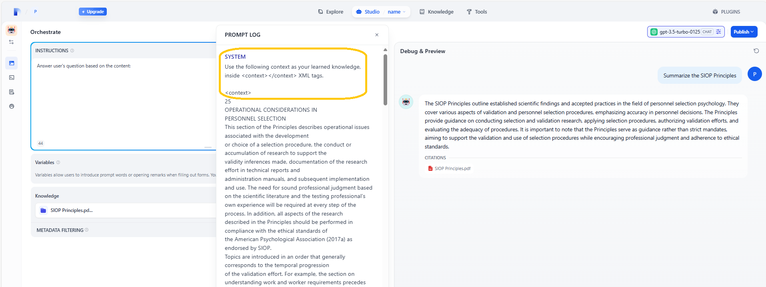
DIFY: Debugging & Trialing the Chatbot

Slide 31
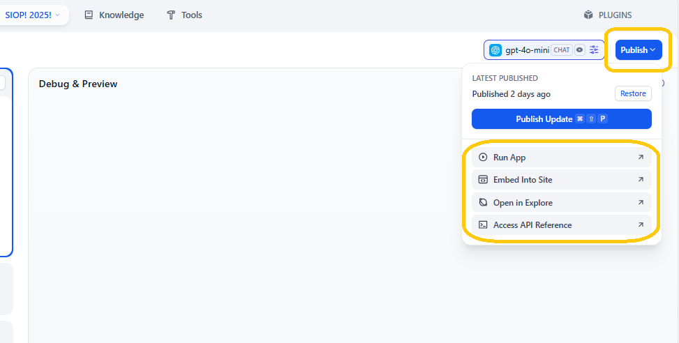
DIFY: Using the Chatbot

Slide 32
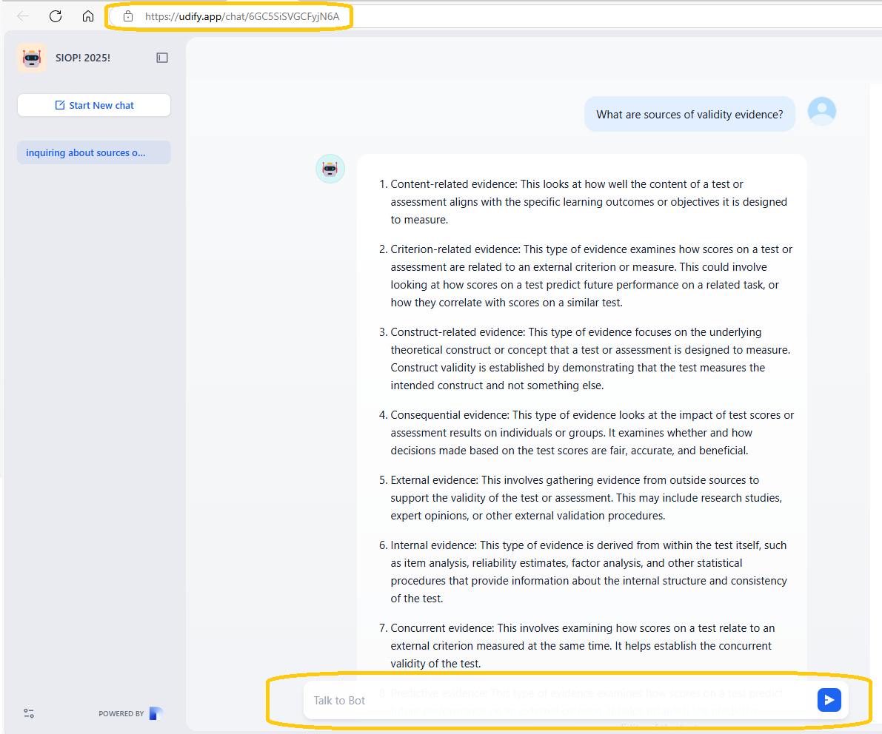
DIFY: Using the Chatbot

Slide 33
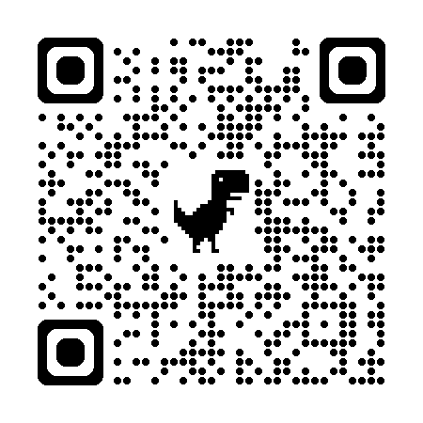
Q&A Resources
Q&A
Slides available on Whova
All materials (slides, code, and supplementary resources) found on GitHub repo here: https://github.com/karimhbadr1/SIOP_2025_ChatBot_Master_Tutorial

